Slide 1



South Westphalia University of Applied Sciences
Data Science Project Seminar Driving Corporate Performance
Summer Semester 2025
Euro 2024 Ticket Trends: A Data-Driven Approach to Fan Engagement
Md Abdullah Al Noman Mridha (Matriculation number: 30494592)

Slide 2

Dataset Preparation
Feature | Derived From | Purpose/use
Region | Original “Country” Column | Group 50+ countries into continents for regional trend analysis
Price Category | “Price” Column | Categorize tickets into low/Medium/High tiers for segmentation
Gender Group | Original “Gender” (08 Categories) | Standardize into Male/Female/other for cleaner demographic analysis
Email Domain Type | “Email Domain” column | Classify as Corporate/Personal/Generic to assess buyer authenticity
Device Ecosystem | “Mobile Device” Column | Group into Apple/Android/Other for spending pattern comparison
Payment Risk Tier | “Payment Method” + “Price” | Flag risky transactions
Major card brand | Payment solution | To categorize mostly used card for payments
Folie 2

Slide 3
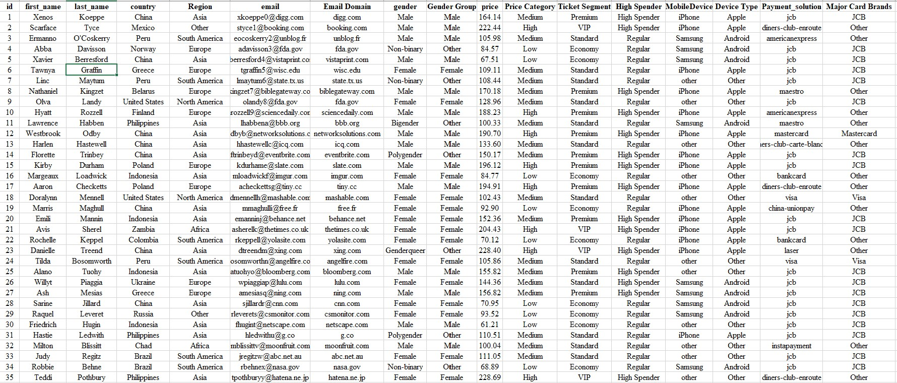
Dataset Overview
Folie 3

Slide 4
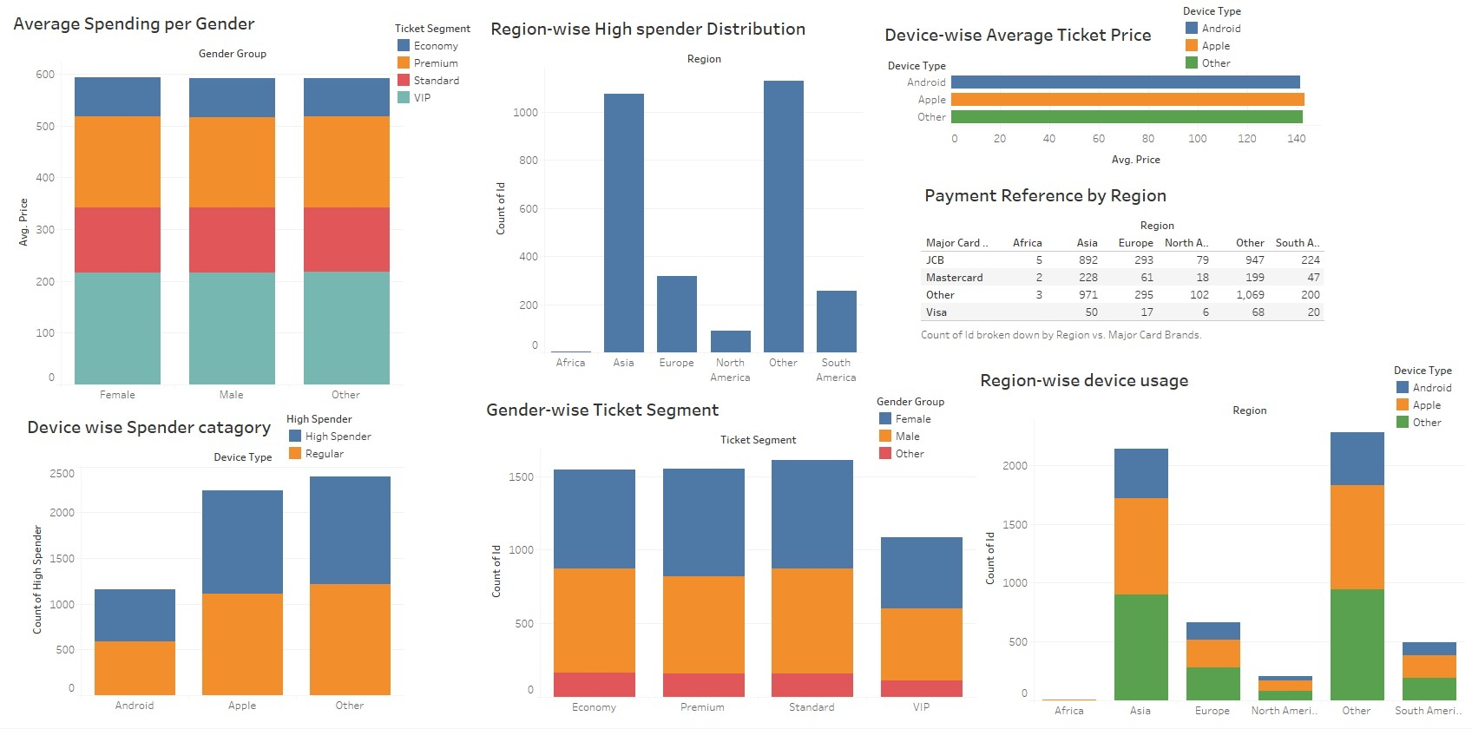
Engagement Trend & Critical Metrics
Folie 4

Slide 5
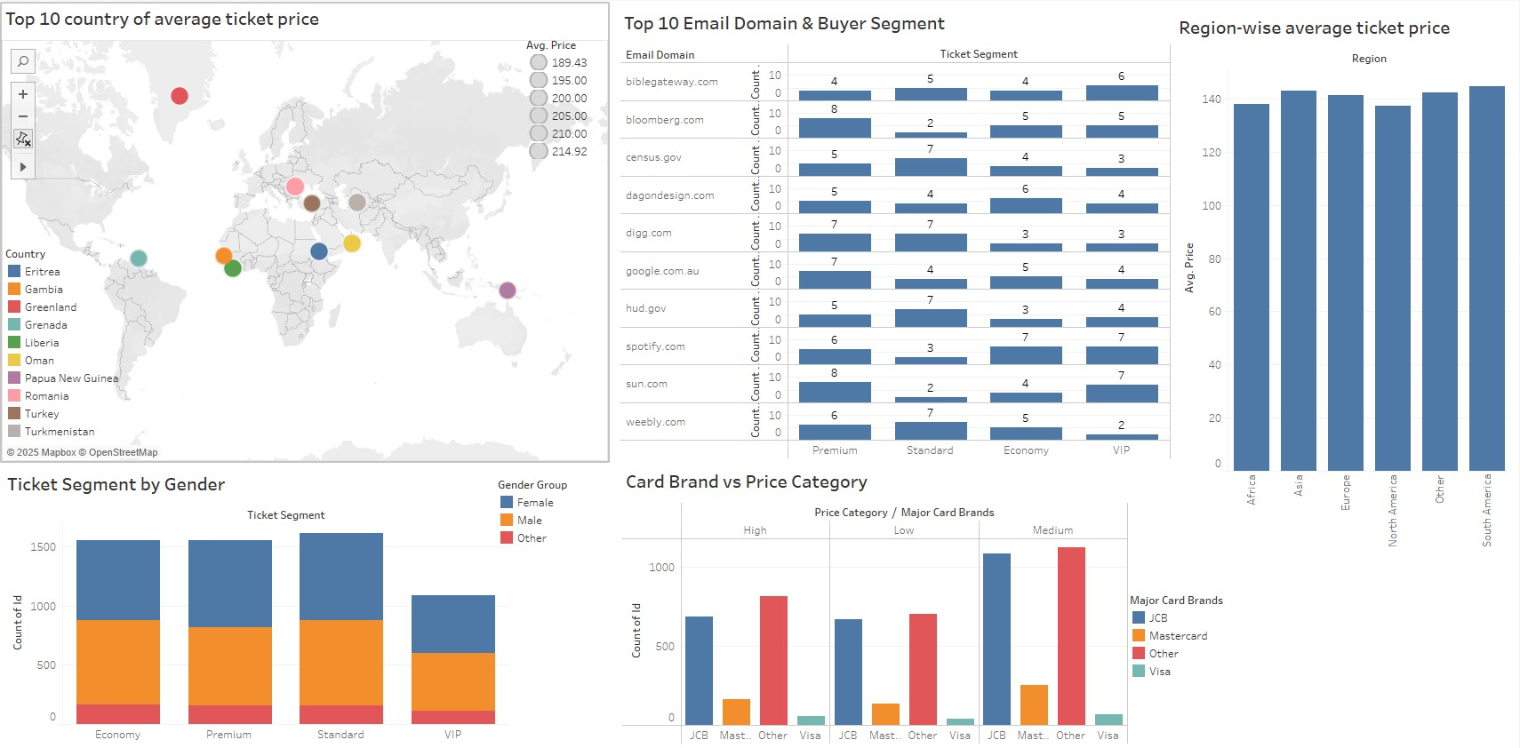
Engagement Trend & Critical Metrics
Folie 5

Slide 6
Tools Used
Results
Excel (For creating features, Filtering and quick aggregation.
Tableau Public: For dashboards presentation
Total user count: 5796
Male: 2570, Female: 2629, Other: 597
Least Region of Ticket purchaser: Africa (10)
Top Region of Ticket Purchaser: Asia (2141)
Total Amount of Transaction: 825750.00
Total Price Category breakdown:
Low: 1547, Medium: 2531, High: 1718
Device Brand Type Breakdown:
Android: 1162, Apple: 2237, Other: 2397
Top Card Brand used for Ticket purchase are:
JCB: 2440, Visa: 161, Mastercard: 555, Other: 2640.
High Spender number of user: 2878
Folie 6

Slide 7
Engagement Trend & Critical Metrics
Popular Payment Brand: JCB (most frequently used).
Top High-Spending Country: China (based on frequency in the dataset).
JCB is widely used, especially in Asia; Visa and Mastercard more in Europe.
The dataset includes a diverse range of nationalities, with a strong presence from Asia and Europe.
High spenders are more likely to use iPhones and purchase Premium or VIP tickets.
The majority of transactions fall under the "Medium" price category.
Apple (iPhone) is the most used device across bookings.
Males dominate in number of bookings, but females show high VIP engagement.
Users from countries like Germany, Norway, Finland tend to purchase Premium/VIP tickets more often.
Users from Indonesia, Philippines, Zambia often purchase Economy or Standard seats.
Maestro and UnionPay users tend to make low-to-mid-value purchases.
Non-binary, Polygender, and Genderqueer users are more likely to spend above average, often choosing Premium or VIP tickets.
Professional or government email addresses (gov, edu, org) tend to appear in Standard bookings.
Free domain users (gmail, yahoo, outlook) are spread across all segments.
Folie 7

Slide 8
Hypothesis & Pattern Interpretation
Pattern: Price Distribution by gender (gender + Average ticket price).
Hypothesis: Males and females may purchase different-priced seats
Pattern: Price vs gender + device
Hypothesis: Females prefer iPhone and mid-range seats
Pattern: Price vs device
Hypothesis: Samsung users spend less per ticket
Pattern: Payment + Country
Hypothesis: JCB users are mostly from Asia (China, Japan)
Pattern: Price vs Payment method
Hypothesis: Visa and Mastercard users pay more
Pattern: Region + High Spender status
Hypothesis: Users from Europe and North America are more likely to be High Spenders.
Pattern: Payment Method + Average Ticket Price
Hypothesis: Users paying with Mastercard or Visa spend more on average than those using JCB or prepaid solutions.
Pattern: Country + Ticket Segment
Hypothesis: Users from high-income countries (e.g., Germany, Norway) prefer Premium/VIP tickets, while users from developing countries tend to buy Standard or Economy.
Pattern: Email Domain + Price Category
Hypothesis: Users with institutional domains (e.g., .edu, .gov) tend to purchase Standard tickets, while personal domains like Gmail are spread across all price tiers.
Folie 8

Slide 9


Thank you!
Do you have any questions?

